Slide 1
HPredict: A Machine LearningBased Model for Treatment Cost Estimation
Bridging Technology and Healthcare Economics By: Ganaprathyusha Puluputhuri Muni, Kavana Anil, Neha Sharma, Nivedita Venkatachalam

Slide 2
Problem Statement
Background: Healthcare costs in the USA account for around 25% of an average household's annual income, with individuals spending approximately $13,000 annually on medical expenses.
Challenge: Lack of visibility into healthcare costs and the factors influencing them leads to financial strain on patients and inefficiencies in insurance and healthcare operations.
Objective: Develop "HPredict" model for transparently estimating healthcare costs based on factors like age, disease type, medical history, and length of stay, aiding financial planning for patients and families.
Approach: Use statistical techniques for data preparation and apply advanced machine learning methods such as XGBoost, Random Forest, GB Regressor and regression models.
Goal: Improve predictability and transparency of healthcare costs, aiding patients in financial planning and enhancing claim management for insurers and healthcare facilities.
Evaluation Metrics: Assess model performance using MSE, MAE, RMSE, and Rsquared.

Slide 3
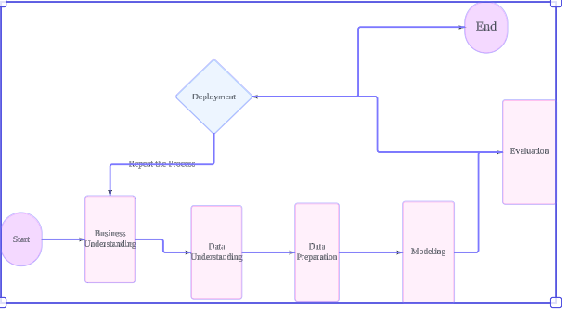
Project Methodology and Flow

Slide 4
Project Requirements
Functional Requirements
Scaling: Standardize and normalize data for uniform model contributions.
Encoding: Convert categorical data to numerical values for model processing.
Feature Engineering: Identify and utilize significant features for improved model performance.
ML Requirements
Machine Learning Models: Implement Linear Regression, Polynomial Regression, Random Forest, XGBoost, and SGD Regressor.
Evaluation Metrics: Assess model accuracy using MAE, MSE, RMSE, and Rsquared.
Data Requirements
Data Sources: Utilize comprehensive datasets from relevant sources.
Data Volume: Manage large datasets, expecting approximately 1 million records postpreprocessing.
Target Outcomes
Reliable Cost Estimates: Provide accurate healthcare cost predictions.
Decision Support: Aid in insurance claims management and healthcare service provisioning.
Technological Tools and Integration
Advanced Analytics: Leverage cuttingedge tools for data processing and model development.
Integration: Ensure seamless integration with existing healthcare IT infrastructures.

Slide 5
Data Process
Data Gathering:
Collect healthcare data from hospitals and government surveys.
Capture patient demographics, medical histories, and treatment costs.
Data Cleaning:
Remove outliers and duplicates.
Handle missing values and inconsistencies.
Ensure dataset reliability through strict procedures.
Data Integration:
Merge and harmonize data from both sources.
Standardize data formats.
Feature Engineering:
Extract insights and enhance predictions.
Standardize numeric features and encode categorical variables.

Slide 6
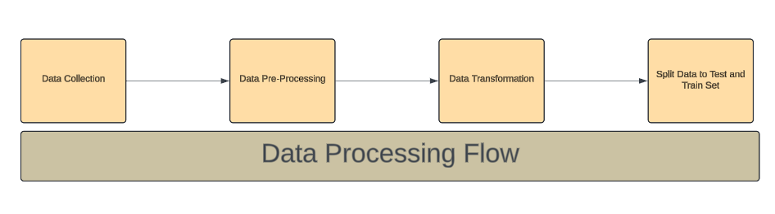
Model Training:
Train ML algorithms to identify patterns.
Select the most effective model for deployment.
Model Evaluation:
Assess model performance using metrics like RMSE.
Iterate and improve model accuracy.
Model Maintenance:
Monitor and update the model regularly.
Retrain with fresh data to remain relevant.
Outcome:
Guide resource allocation and healthcare planning.
Improve patient outcomes and operational efficiency.

Slide 7
Data Collection
Collecting data from 2 sources and merging them to consider all possible contributing features for healthcare cost.
Data From Federal Survey
Purpose of data collection? | The objective of gathering information through surveys administered by federal agencies is to acquire a good understanding of various factors affecting the cost of healthcare, encompassing patient demographics, medical background, lifestyle preferences etc.
Utilization of Data | The information gathered will be utilized to create prediction models that will enable the healthcare industry to more easily allocate resources and manage finances by providing an accurate estimate of healthcare expenditures.
Units of measurement | Rows of Data Collected
Variables | Various features such as gender, age, reason for hospitalization etc.
Datatype of variables | Text and numeric
Collection Method | Download from the federal site and merge the data from all years

Slide 8
Data From Inpatient Discharge
Purpose of data collection? | The objective of gathering information through inpatient admission and their medical expense in each state is to understand how various factors have impacted the cost of healthcare.
Utilization of Data | The information gathered will be utilized to create prediction models that will enable the healthcare industry to more easily allocate resources and manage finances by providing an accurate estimate of healthcare expenditures.
Units of measurement | Rows of Data Collected
Variables | Various features such as gender, age, reason for hospitalization etc.
Datatype of variables | Text and numeric
Collection Method | Download from the federal site and merge the data from all years

Slide 9
Data Preprocessing
Address differences in patterns, column numbers, and features in the final dataset.
Identify and analyze null values
Handle Outliers
Analyzing the datatype and information of each column
Understanding the distribution of each column in the dataset.

Slide 10
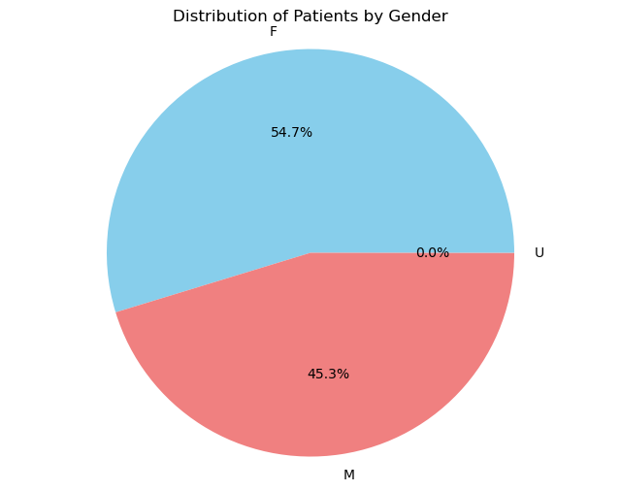
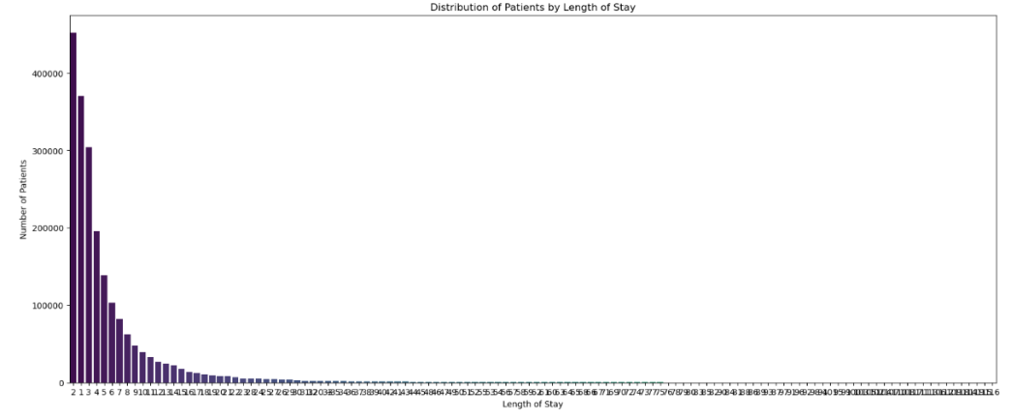
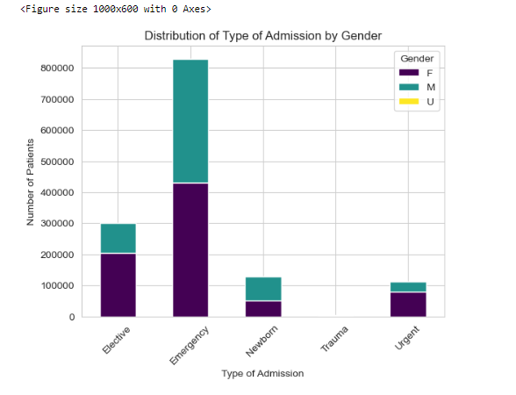
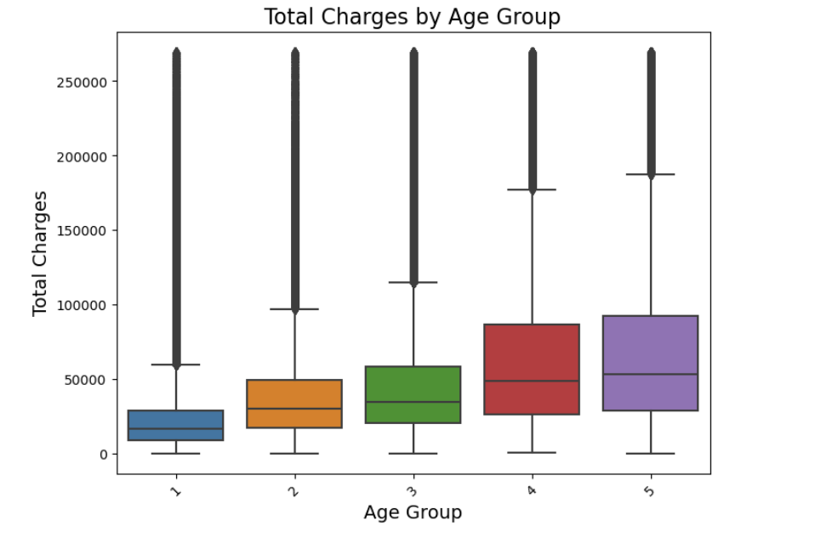

Slide 11
Data Transformation
Data transformation is the process of converting data from one format or structure into another.
Tools used : python, pandas, NumPy and Scikitlearn.
In preparing data for machine learning models, we have to ensure that data is properly formatted by using several transformation techniques.
Core techniques in Data Transformation : Normalization, standardization, Encoding, Dimension Reduction.

Slide 12
Handling Missing values.
Encoding Age Group, Emergency Department Indicator, APR Risk of Mortality, Gender.
Data type transformations have been performed to ensure that numerical columns are formatted properly for modeling.

Slide 13
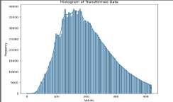
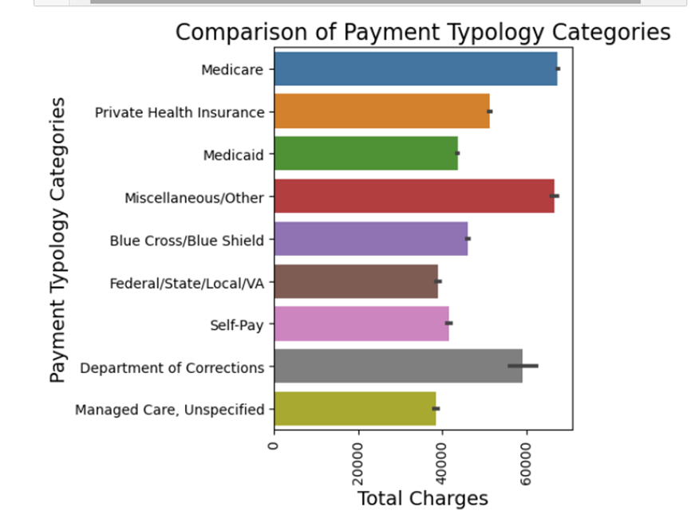
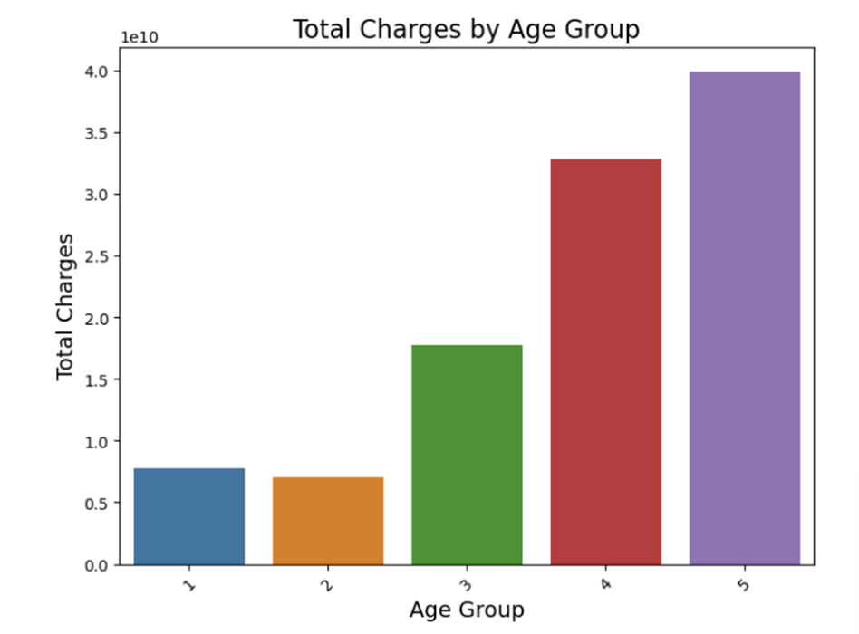
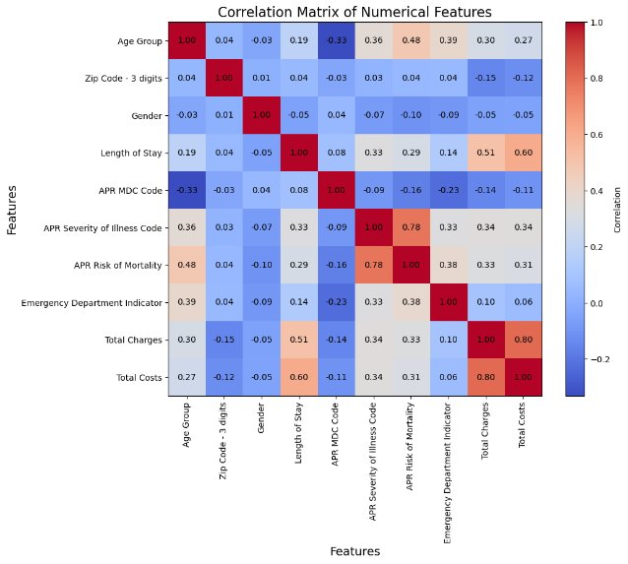
EDA after Data Transformation

Slide 14
Data Preparation
After preprocessing, we split our data for model training, testing and validation to ensure unbiased, representative subsets.
Purpose of Splitting:
Training (60%): To comprehensively train the regression model predicting hospital costs.
Testing (20%): To evaluate model performance on unseen data.
Validation (20%): To finetune model hyperparameters and prevent overfitting.
Significance:
Ensures models are trained and tested on diverse and ample data.
Helps achieve more accurate and reliable predictions of hospital costs.

Slide 15
Data Statistics
Data Collection:
Hospital Inpatient Discharges: 2,061,634 rows × 33 columns.
CCS Procedure Codes: 329 rows × 7 columns.
CCS Diagnostic Codes: 1,295 rows × 2 columns.
Data Preprocessing Steps:
Merging data sources: Resulted in 5,826,425 rows.
Removing redundant data, columns with high missing values.
Replacing missing values in specific columns.
Outlier handling and data reduction to 1,931,761 rows × 20 columns.
Data Transformation:
Encoding categorical variables into numerical categories.
Dummy encoding and data type changes.

Slide 16
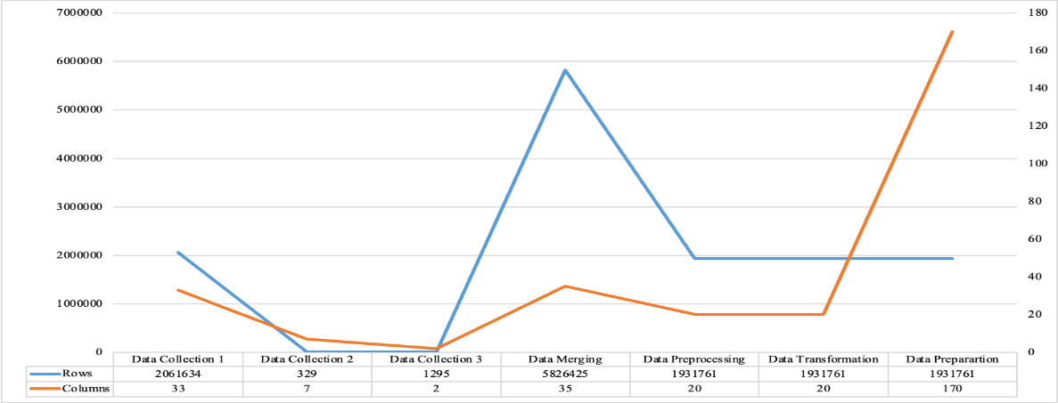
Data Transformation & Preparation
Data Transformation Continued:
Comprehensive transformation techniques led to a final dataset of 1,931,761 rows × 170 columns.
Data Preparation:
Data split into training (60%), testing (20%), and validation (20%).
Resulting in:
Training: 1,159,056 rows × 170 features.
Validation: 386,352 rows × 170 features.
Testing: 386,353 rows × 170 features.

Slide 17
Model Development and Evaluation Metrix
Models
Linear Regression
Polynomial Regression
Random Forest
XG Boost
Gradient Boost
Evaluation Metrix
MSE
RMSE
R^2
MAE

Slide 18
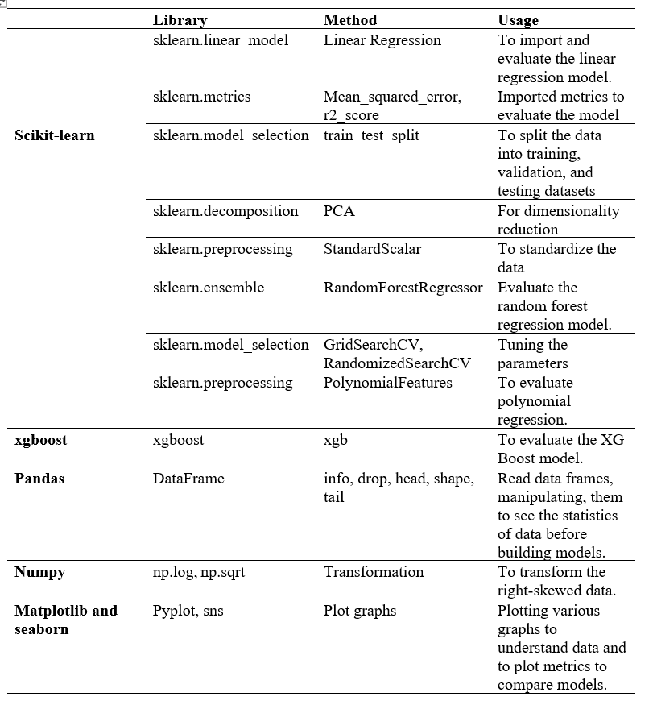
List of libraries used for model development

Slide 19
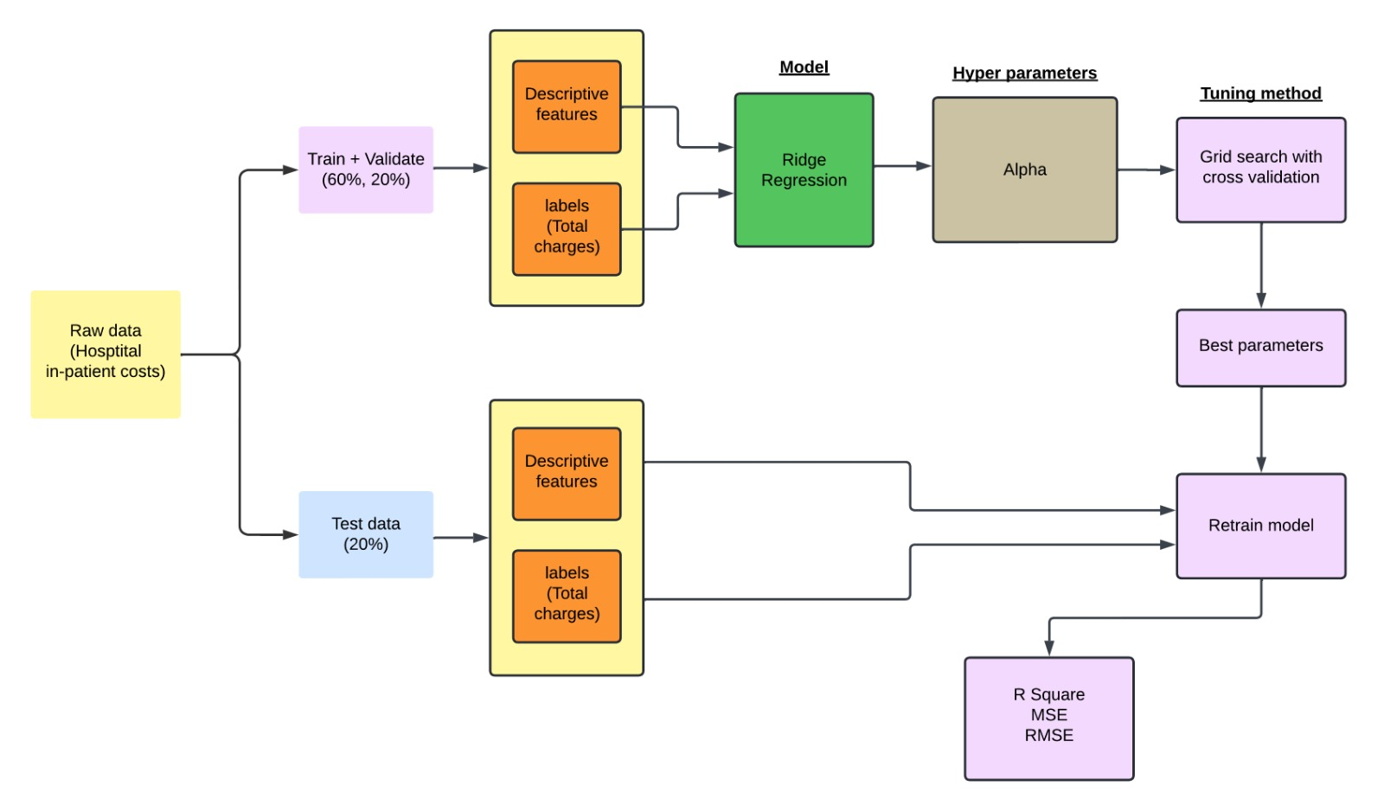
Systematic architecture for Linear regression model with hyperparameter tuning

Slide 20
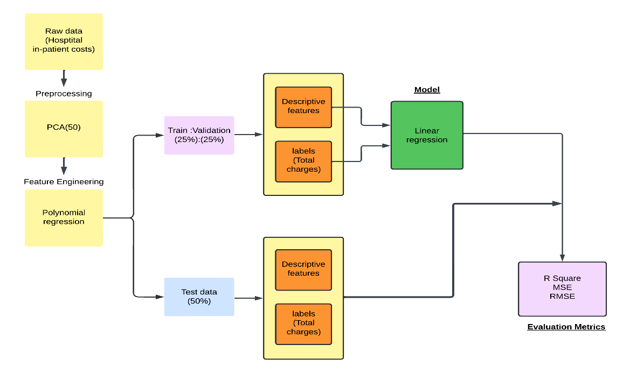
Architecture and dataflow for polynomial regression

Slide 21
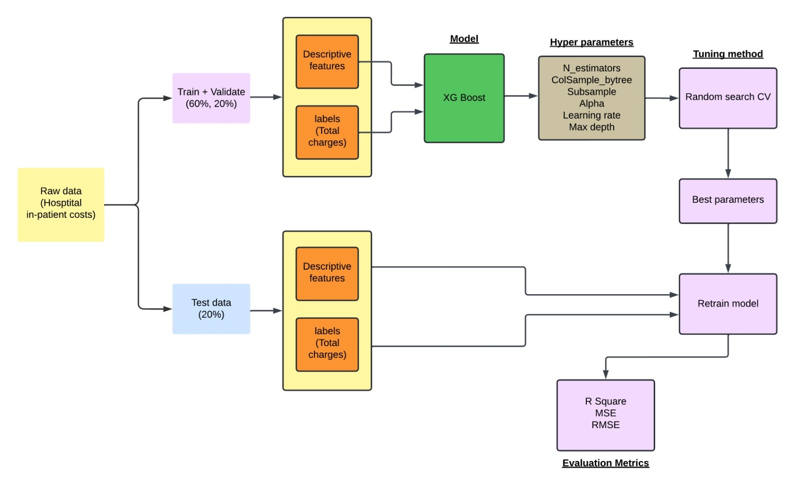
Architecture and dataflow for XG Boost

Slide 22
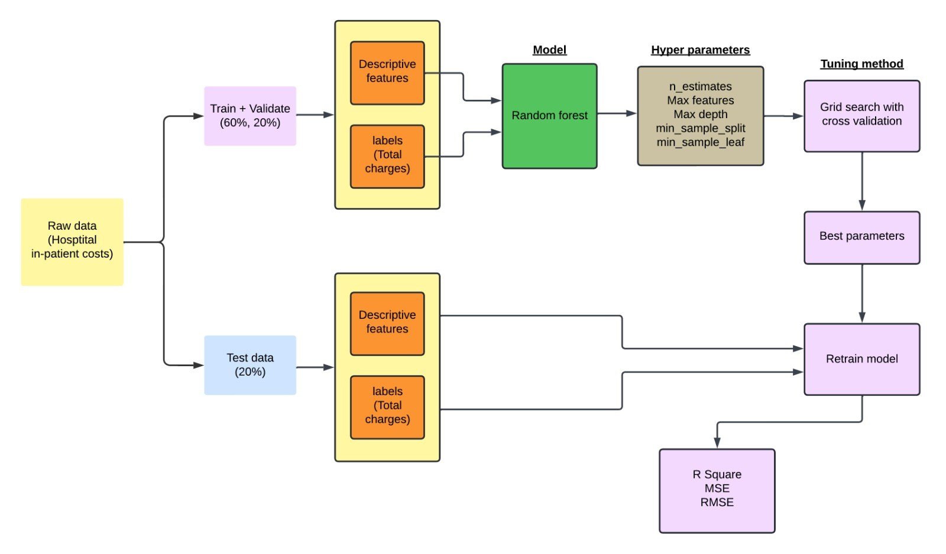
Architecture and dataflow for Random Forest

Slide 23
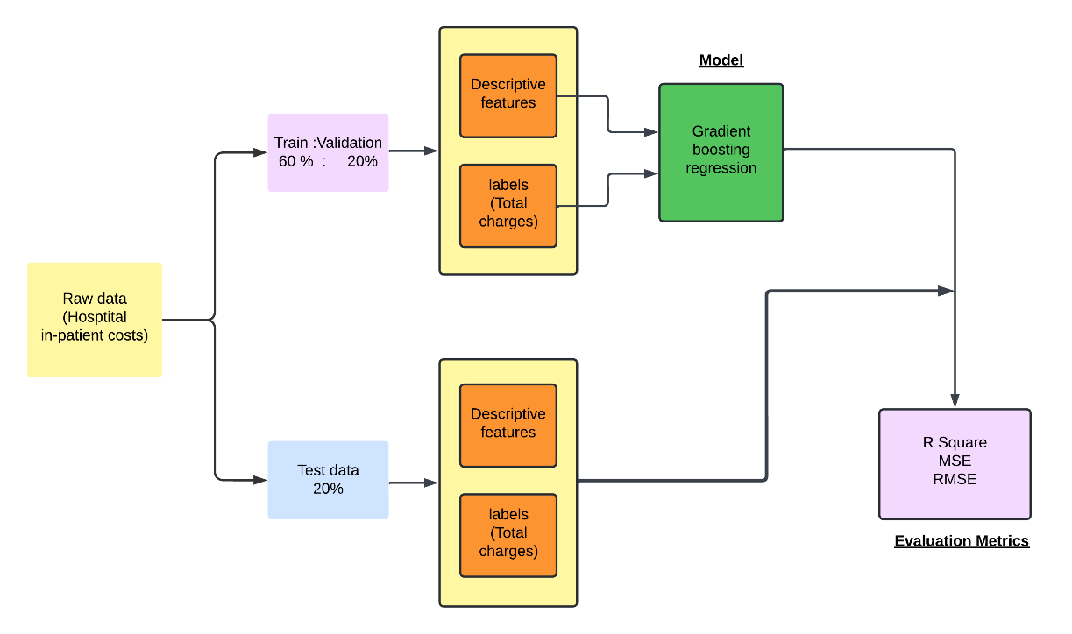
Architecture and dataflow for gradient boosting regressor

Slide 24
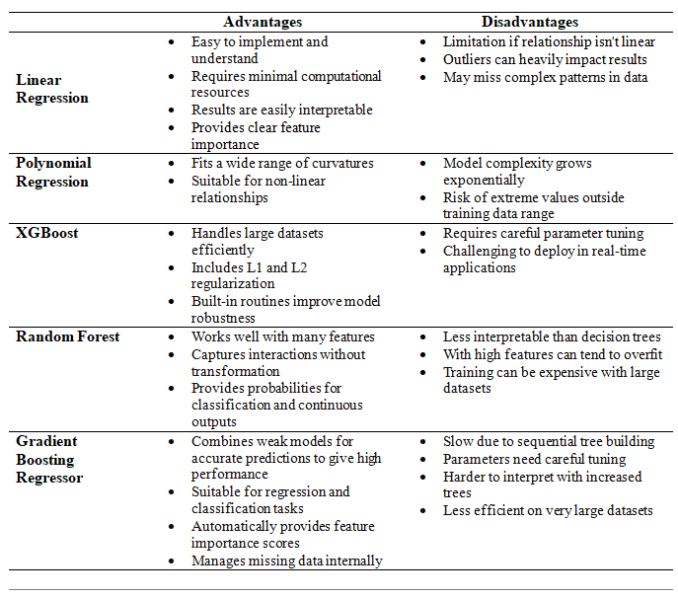
Models comparative analysis

Slide 25
Justifications for models
Linear Regression : Ideal for linear relationships, simple and interpretable
Polynomial regression : for non-linear relationships.
Random Forest : For large datasets, Reduce overfitting.
XGBoost : handles large datasets and efficient for its speed and performance.
Gradient Boosting : Efficient in handling large datasets by reducing the loss function.

Slide 26
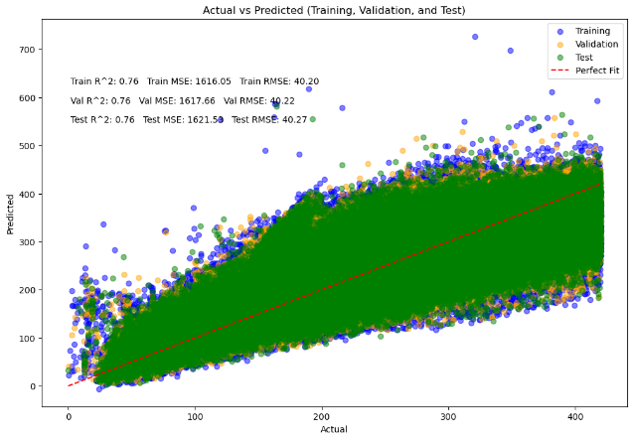
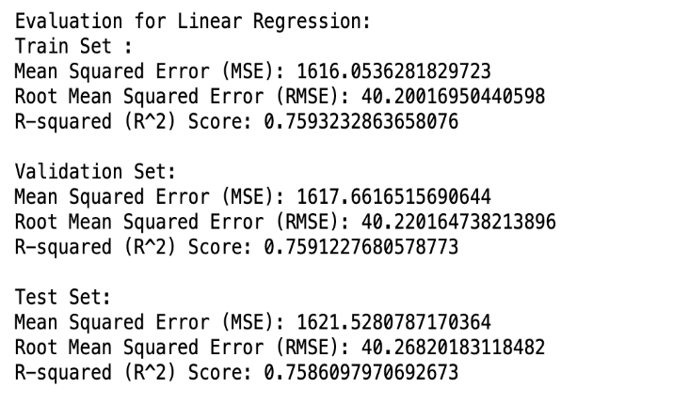
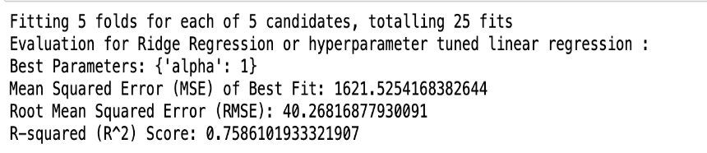
Evaluations Linear Regression
Baseline Model
Hyperparameter tuned model

Slide 27
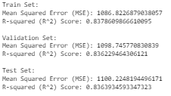
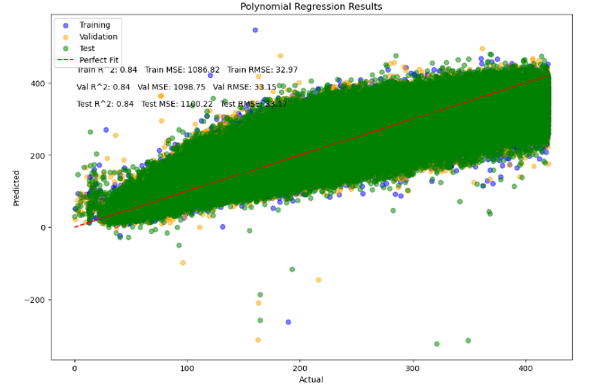
Polynomial Regression

Slide 28
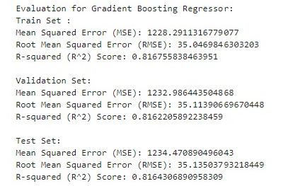
Gradient Boosting

Slide 29
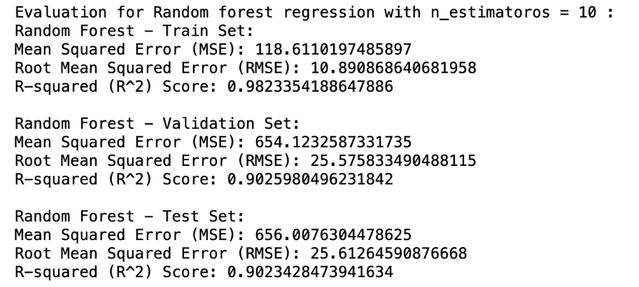
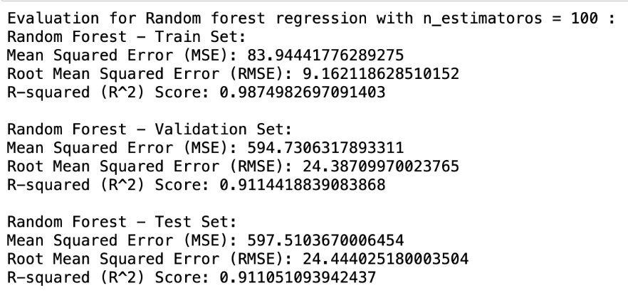
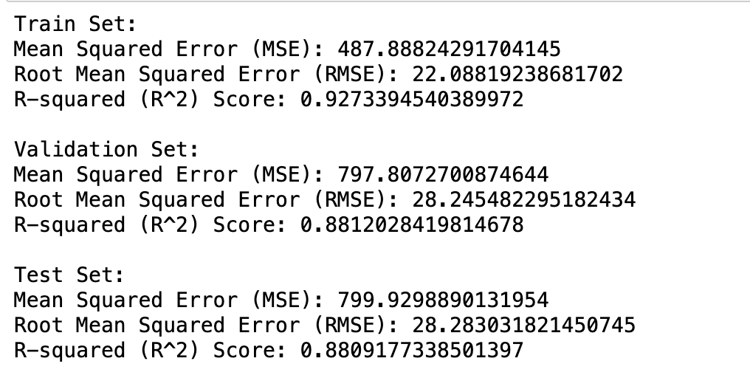
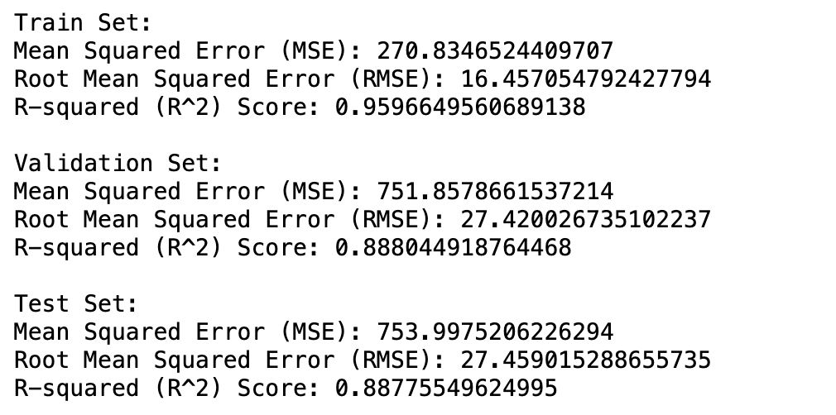
Random Forest
Baseline Model
Hyperparameter tuned model
CV=5 CV=3

Slide 30
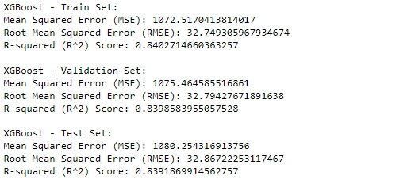
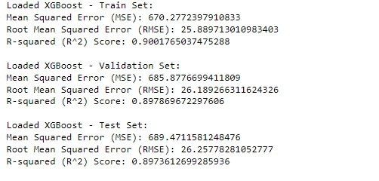
XGBoost
Baseline Model:
Hyperparameter Tunned Model:

Slide 31
Results and Comparison of Model performance
Model | Train |  |  | Test
 | MSE | RMSE | R Squared | MSE | RMSE | R Squared
Linear Regression | 1616.05 | 40.20 | 0.759 | 1621.52 | 40.27 | 0.758
Polynomial Regression | 1086.82 | 32.96 | 0.837 | 1100.22 | 33.16 | 0.836
Random Forest | 83.94 | 9.16 | 0.987 | 597.51 | 24.44 | 0.911
Gradient Boosting | 1228.29 | 35.04 | 0.816 | 1234.47 | 35.13 | 0.8164
XGBoost | 670.27 | 25.88 | 0.900 | 689.47 | 26.25 | 0.897

Slide 32
Thank You

